Slide 1
MCDA 5550 - Web App Development Chapter 04: Making apps do significant computing
Instructor: Dinesh kG

Slide 2
Temperature converter
Between Fahrenheit or Celsius
User decides which unit should be used for the value entered

Slide 3
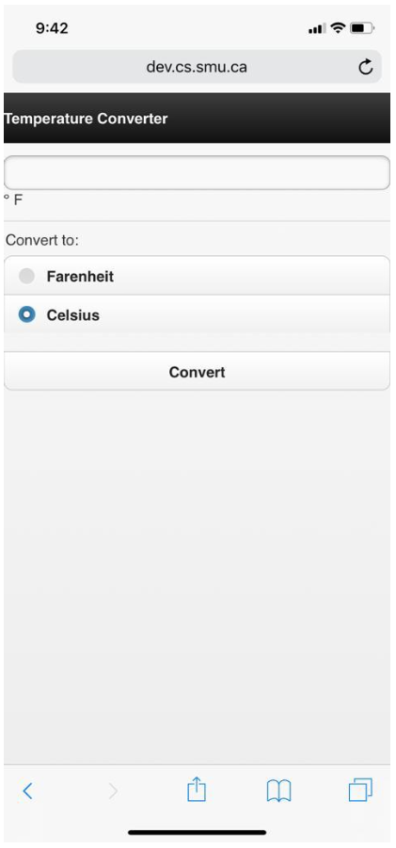
Heads Up!
Can you identify the elements?

Slide 4
Review
<!DOCTYPE html>
<html>
<head>
<title>Temperature Converter</title>
<link rel="stylesheet" href="http://code.jquery.com/mobile/1.3.1/jquery.mobile-1.3.1.min.css" />
<script src="http://code.jquery.com/jquery-1.8.3.min.js">
</script>
<script src="http://code.jquery.com/mobile/1.3.1/jquery.mobile-1.3.1.min.js">
</script>
<script src="js/temperatureConverter.js" type="text/javascript">
</script>
<meta name="viewport" content="width=device-width, initial-scale=1.0">
</head>

Slide 5
Investigate
data-role=“fieldcontain”
To improve the styling of labels and form elements on wider screens, wrap around each label/form element.
Also add a thin bottom border to act as a field separator.
<div data-role="fieldcontain">
<input type="number" id="temperature“ name="temperature">
<label id="label">&deg; F</label>
</div>

Slide 6
Special characters
° &deg;
(space) &nbsp;
& &amp;
© &copy;
¼ &frac14;
½ &frac12;
¾ &frac34;
× &times;
÷ &divide;
∑ &#8721;
Δ &#916;
← &#8592;
↑ &#8593;
→ &#8594;
↓ &#8595;
Ω &#8486;
Many more…

Slide 7
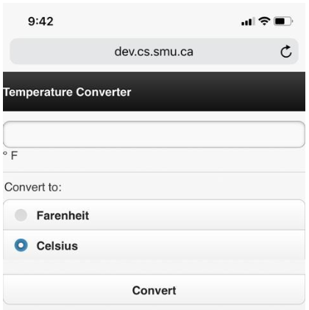
Cont’d…
<fieldset data-role="controlgroup">
<legend>Convert to:</legend>
<input type="radio" name="units"
id="farenheit" value="farenheit">
<label for="farenheit">Farenheit</label>
<input type="radio" name="units"
id="celsius" value="celsius"
checked="checked">
<label for="celsius">Celsius</label>
</fieldset>

Slide 8
Cont’d…
<fieldset> groups elements in a form
<legend> caption for the fieldset
<input type="radio" > radio button
For radio buttons, name attribute is used to indicate the same grouping
Selecting one button deselects the currently selected button

Slide 9
Specify actions for elements
Before we did see (in HTML):
<button onclick="display();">
In JavaScript:
document.getElementById(“targetID").onclick = display();

Slide 10
Cont’d…
<body onload="setup();">
function setup()
{
document.getElementById("farenheit").onclick=
function(){setUnits("C");};
document.getElementById("celsius").onclick=
function(){setUnits("F");};
}

Slide 11
Cont’d
<input type="button" onclick="convert()“ value="Convert">
<p id="answer"></p>

Slide 12
Cont’d
function convert()
{
var celsiusButton = document.getElementById("celsius");
var temperature = document.getElementById("temperature");
if(celsiusButton.checked)
{
convertToCelsius(temperature.value);
}
else
{
convertToFahrenheit(temperature.value);
}
}

Slide 13

Conversion formulae

Slide 14
Cont’d…
function convertToCelsius(temperatureInFahrenheit)
{
var celsiusTemperature=(temperatureInFahrenheit-32)*5/9;
document.getElementById("answer").innerHTML=
temperatureInFahrenheit+"&deg; Fahrenheit converts to "+
celsiusTemperature.toFixed(1)+"&deg; Celsius";
}
function convertToFahrenheit(temperatureInCelsius)
{
var fahrenheitTemperature=temperatureInCelsius*9/5+32;
document.getElementById("answer").innerHTML=
temperatureInCelsius+"&deg; Celsius converts to "+
fahrenheitTemperature.toFixed(1)+"&deg; Fahrenheit";
}

Slide 15
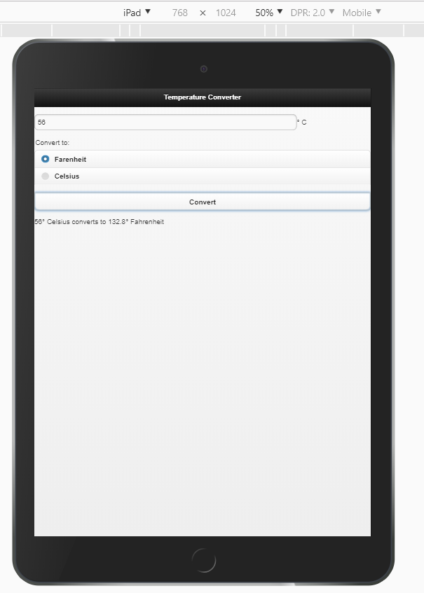
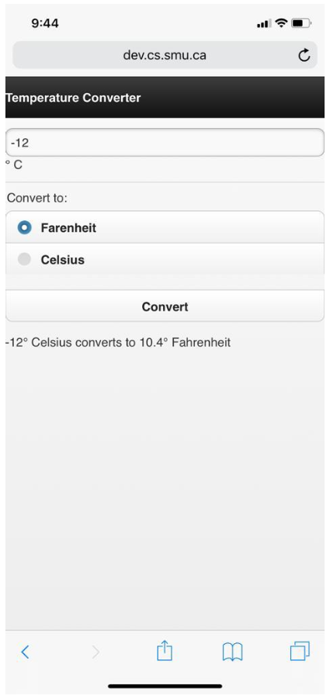
Putting it altogether

Slide 16
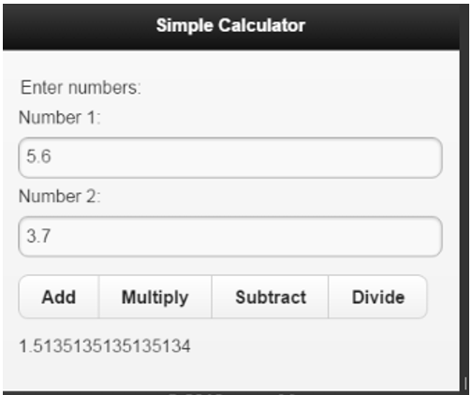
Assignment #1 (Simple Calculator)
Upload your app to the server!

Slide 17
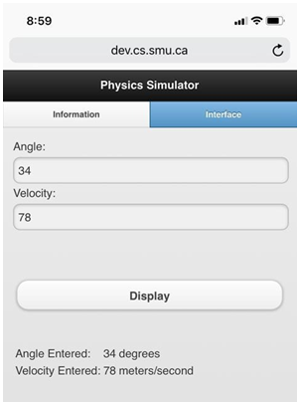
Going back to Projectile app
Before, we just retrieved and displayed user input

Slide 18
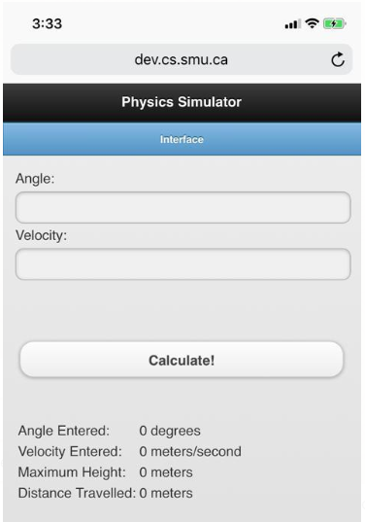
Going back to Projectile app
This time, manipulate the user input

Slide 19
Setting up actions
When user enters values…
Do the error checking
function initialize()
{
var angleInput=document.getElementById("angle");
angleInput.addEventListener("mouseout", validateAngle);
var velocityInput=document.getElementById("velocity");
velocityInput.addEventListener("mouseout ", validateVelocity);
}

Slide 20
addEventListeners
We’ve seen
element.onlick = function;
Another way to specify actions (not supported in some earlier IE)
element.addEventListener(“click”, function);

Slide 21
Other commonly used events
blur | when the element loses focus
click | when the user clicks on the element
dblclick | when the user double-clicks on the element
focus | when the element receives focus
load | when an object has been loaded
mouseover | when the user moves the mouse pointer into the element
mouseout | when the user moves the mouse pointer out of the element

Slide 22
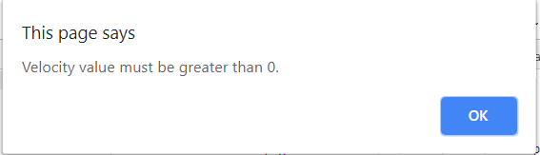
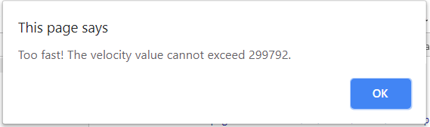
Value validation and warning
function validateVelocity()
{
var velocityInput=document.getElementById("velocity");
if(velocityInput.value<1)
{
alert('Velocity value must be greater than 0')
velocityInput.value="";
}
else if(velocityInput.value> 299792)
{
alert('Too fast! The velocity value cannot exceed 299792 ');
velocityInput.value="";
}
}

Slide 23
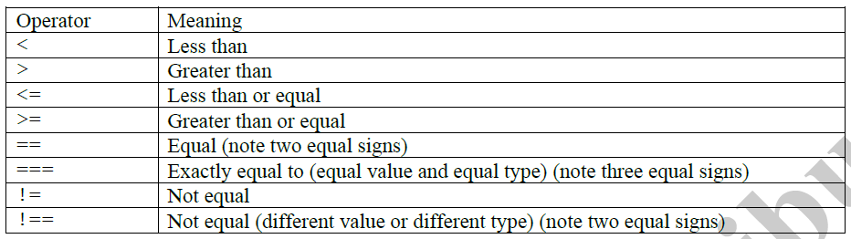
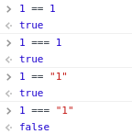
Value comparisons

Slide 24
Logical operators
OR ||
AND &&
NOT !

Slide 25
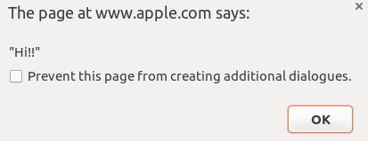
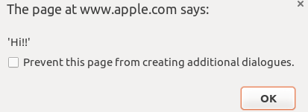
Double and single quotations
In JavaScript, you can use either “ ” or ‘ ’ to represent Strings
Needs to be in pairs (of course!)
e.g.)
alert('"Hi!!"');
alert("'Hi!!'");

Slide 26
Now calculate!
<button onclick='update();'>
function update()
{
var angle=document.getElementById("angle").value;
var velocity=document.getElementById("velocity").value;
calculate(angle, velocity);
}

Slide 27
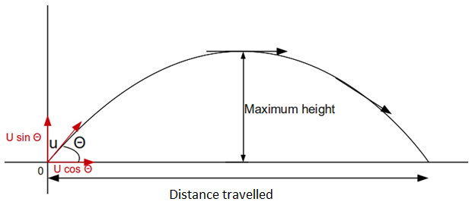
Trajectory calculation

Slide 28
Cont’d…
function calculate(angle, velocity)
{
var horizontalVelocity = velocity*Math.cos((angle*Math.PI)/180);
var verticalVelocity = velocity*Math.sin((angle*Math.PI)/180);
var tMaxHeight = verticalVelocity/9.81;
var tLanding = 2*tMaxHeight;
document.getElementById('height').innerHTML
= calcHeight(verticalVelocity, tMaxHeight);
document.getElementById('distance').innerHTML
= calcDistance(horizontalVelocity, tLanding);
}

Slide 29
Cont’d…
function calcHeight(verticalVelocity, time)
{
var height = (verticalVelocity*time) - (0.5*9.81*time*time);
return height;
}
function calcDistance(horizontalVelocity, time)
{
var distance = horizontalVelocity*time;
return distance;
}

Slide 30
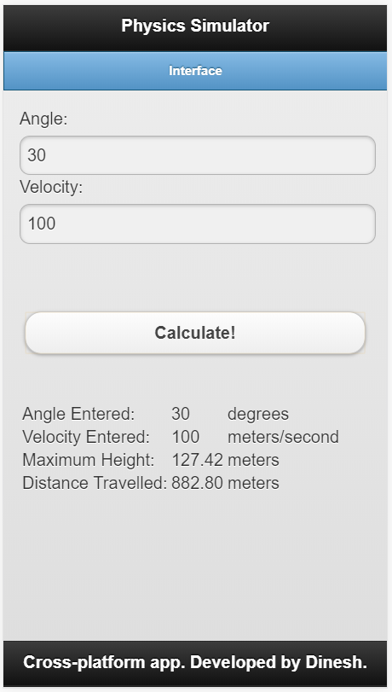

Slide 31
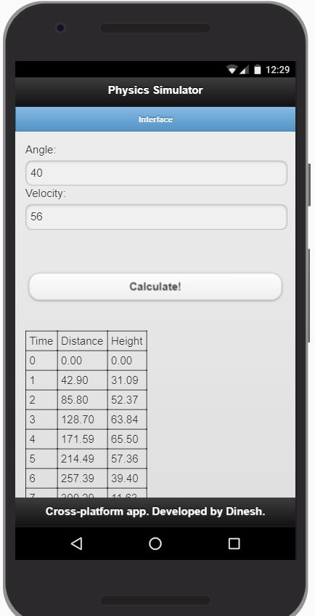
Final changes
Draw a table that tracks the movement of the projectile over time

Slide 32
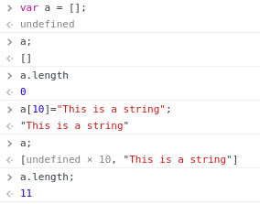
Arrays
JavaScript arrays are “dynamic”

Slide 33
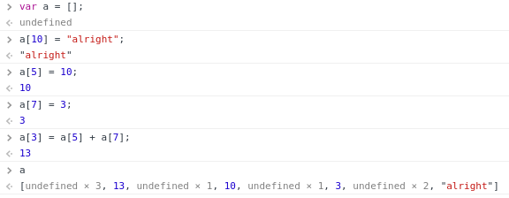
Accessing array elements

Slide 34
Basic JavaScript Array functions
a.push(13); //add an element at the end
a.unshift(90); //add an element at the beginning
var last = a.pop(); //remove and return the last element
var first = a.shift(); //remove and return the first element
a.reverse();
a.sort();
var b = a.slice(0,4); //subset of elements (indices 0 to 3)
var c = a.concat(b);
var e=["c","c++","java","javascript","jquery","node.js"];
a.indexOf(10);
var d = a.join(); //"13alright,,,13,,10,,3,,,alright“
var d = a.join(" "); // "13alright 13 10 3 alright"

Slide 35
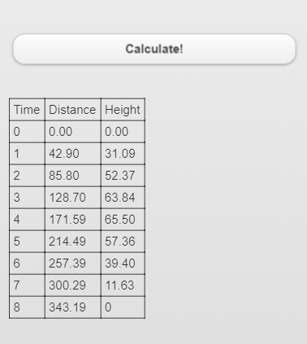
Modify to display a table

Slide 36
Old calculate() function
function calculate(angle, velocity)
{
var horizontalVelocity=velocity*Math.cos((angle*Math.PI)/180);
var verticalVelocity=velocity*Math.sin((angle*Math.PI)/180);
var tMaxHeight=verticalVelocity/9.81;
var tLanding=2*tMaxHeight;
document.getElementById('height').innerHTML=
calcHeight(verticalVelocity, tMaxHeight);
document.getElementById('distance').innerHTML=
calcDistance(horizontalVelocity, tLanding);
}

Slide 37
New calculate() function
function calculate(angle, velocity)
{
var horizontalVelocity=velocity*Math.cos((angle*Math.PI)/180);
var verticalVelocity=velocity*Math.sin((angle*Math.PI)/180);
var tMaxHeight=verticalVelocity/9.81;
var tLanding=2*tMaxHeight;
var heightArray=[];
var distanceArray=[];
var timeArray=[];
if(tLanding<2)
{
var interval=0.1;
}
else if(tLanding<20)
{
var interval=1;
}
else
{
var interval=10;
}

Slide 38
Cont’d…
for (var time=0; time<=tLanding+interval; time+=interval)
{
timeArray.push(time);
var height=calcHeight(verticalVelocity, time);
if(height<0)
{
height=0;
}
heightArray.push(height);
var distance=calcDistance(horizontalVelocity, time)
if(distance<0)
{
distance=0;
}
distanceArray.push(distance);
}//end for
updateTable(timeArray, distanceArray,heightArray);
}//end calculate()

Slide 39
Display results
function updateTable(timeArray,
distanceArray,
heightArray)
{
var dataTable
=document.getElementById('data');
dataTable.innerHTML = '';//empty
//Header row
var row=dataTable.insertRow(0);
var timeCell=row.insertCell(0);
var distanceCell=row.insertCell(1);
var heightCell=row.insertCell(2);
timeCell.innerHTML='Time';
distanceCell.innerHTML='Distance';
heightCell.innerHTML='Height';
//Insert data
for(var i=0; i<timeArray.length; i++)
{
var row=dataTable.insertRow(-1);
var timeCell=row.insertCell(0);
var distanceCell=row.insertCell(1);
var heightCell=row.insertCell(2);
timeCell.innerHTML=timeArray[i];
distanceCell.innerHTML=distanceArray[i];
heightCell.innerHTML=heightArray[i];
}//end for
}

Slide 40
Table element functions
insertRow(rowIndex)
insertCell(cellIndex)
Use -1 for index ➔ at the end (alternately could use i+1 (could have also replaced the parameter -1 by i+1.)
var row=dataTable.insertRow(-1);
var timeCell=row.insertCell(0);
var distanceCell=row.insertCell(1);
var heightCell=row.insertCell(2);
timeCell.innerHTML=timeArray[i];
distanceCell.innerHTML=distanceArray[i];
heightCell.innerHTML=heightArray[i];

Slide 41
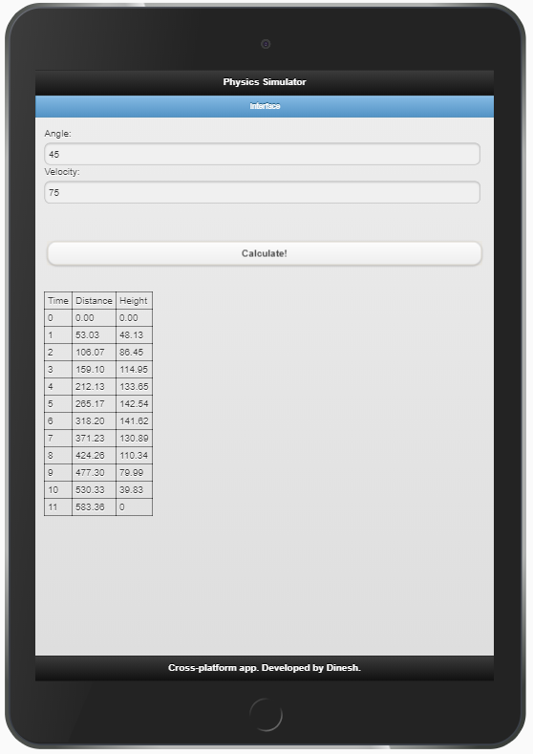

Slide 42
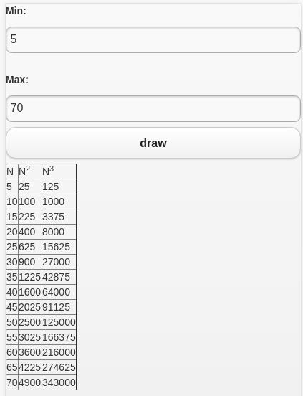
Assignment #2 (arrays and table)
User specifies min and max values
Clicking on “draw” will draw a table
Table has 2 columns
1st column values from min to max (increment by 5)
2nd column squared numbers
Upload your code to the server!

